Slide 1


Green Pace
Security Policy Presentation
Developer: Andres Sanchez
CS-405-13379-M01 Secure Coding 2024 C-5
Southern New Hampshire University
https://youtu.be/9Q5_sACXhks

Slide 2

OVERVIEW: DEFENSE IN DEPTH
The Green Pace Security Policy is designed to provide a comprehensive framework for securing all aspects of software development while defining the core security principles needed to ensure best coding practices. This policy includes clear standards for encryption, authorization, authentication , auditing and others measures which offers guidance for building a secure solution.

Slide 3
THREATS MATRIX
Likely –
These standards address risks that are highly likely and have potential for significant impact to security. These should be addressed first to prevent common vulnerabilities from being exploited.
Priority –
While these are less likely to occur, they still have potential for high impact. That said, they should still be prioritized with those that are likely to mitigate risk.
Low Priority –
These have a lower impact than those classified into likely and priority. While they are still important, it should be addressed only after the others of high priority.
Unlikely -
Issues with these standards show minimal risk and low impact. Its key to still maintain these for best practice but they are less precedence than the others.
Likely STD-002-CPP STD-003-CPP STD-005-CPP STD-009-CPP | Priority STD-001-CPP STD-004-CPP STD-008-CPP STD-010-CPP
Low priority STD-007-CPP | Unlikely STD-006-CPP

Slide 4
10 PRINCIPLES
Validate
Validate Input Data
STD-002-CPP – Data Value
STD-003-CPP – String Correctness
STD-004-CPP – SQL Injection
Heed
Heed Compiler Warnings
STD-001-CPP – Data Type
STD-008-CPP – Memory Protection
Architect and Design
Architect and Design for Security Policies
STD-005-CPP – Memory Protection
Keep
Keep it Simple
STD-010-CPP – Environment
Default
Default Deny
STD-010-CPP – Environment
Adhere
Adhere to the Principle of Least Privilege
Sanitize
Sanitize Data Sent to Other Systems
STD-004-CPP – SQL Injection
Practice
Practice Defense in Depth
STD-008-CPP – Memory Protection
STD-009-CPP – Error Handling
Use
Use Effective Quality Assurance Techniques
STD-002-CPP - Data Value
Adopt
Adopt a secure Coding Standard
STD-001-CPP – Data Type
STD-005-CPP – Memory Protection
STD-006-CPP – Assertions
STD-007-CPP – Exceptions
STD-009-CPP – Error Handling

Slide 5
Coding Standards
Rule​ | Name​ | Severity​ | Likelihood​ | Remediation Cost​ | Priority​ | Level​
STD-003-CPP​ | Guarantee that storage for strings has sufficient space for character data and the null terminator​ | High​ | Likely​ | Medium​ | High​ | 5​
STD-004-CPP​ | Prevent SQL Injection​ | High​ | Likely​ | Medium​ | High​ | 5​
STD-005-CPP​ | Do not access freed memory​ | High​ | Likely​ | Medium​ | High​ | 5​
STD-009-CPP​ | Detect and handle standard library errors​ | High​ | Likely​ | Medium​ | High​ | 5​
STD-002-CPP​ | Ensure that operations on signed integers do not result in overflow​ | High​ | Likely​ | High​ | High​ | 4​
STD-008-CPP​ | Properly deallocate dynamically allocated resources​ | High​ | Likely​ | Medium​ | High​ | 4​
STD-001-CPP​ | Do not define a C-style Variadic function​ | High​ | Probable​ | Medium​ | High​ | 4​
STD-010-CPP​ | Do not call system()​ | High​ | Probable​ | Medium​ | High​ | 4​
STD-007-CPP​ | Handle all exceptions​ | Low​ | Probable​ | Medium​ | Low​ | 3​
STD-006-CPP​ | Use assert() only for debugging purposes​ | Low​ | Unlikely​ | High​ | Medium​ | 2​

Slide 6
ENCRYPTION POLICIES
Encryption in rest
Protects data stored in databases, files or disks.
Examples: Database, Cloud Storage, Archives & Off-site Backups.
Best Practice: Use of advanced encryption standards (AES).
Encryption at flight
Protects data between two end points.
Examples: Emails & Web Traffic.
Best Practice: Use of VPN, Transport Layer Security (TLS) & HTTPS.
Encryption in use
Protects data while actively used by an application or being processed.
Examples: RAM Memory or Application Data.
Best Practice: Use of homomorphic encryption for highly sensitive data.
Notes:
Encryption at Rest refers to protecting data that is stored on a disk, solid state drive or backup media. The goal of this policy to use advanced encryption standards or other similar algorithms to ensure if physical storage is stolen or accessed, the data would be unreadable without the necessary encryption keys. This reduces the surface of an attack and allows teams to focus their security strategy more on encryption then trying to protect all data. This policy applies to databases, cloud storage, archives or off-site backups.
Encryption at flight refers to a concept of protecting data that is transferred between two endpoints such as between two services or between different servers over a network. The goal of this policy is protect data where it may have the most risk of being exposed. Examples such as implementing VPN or Transport Layer Security (TLS) ensures data transmitted over a network remains secure. This applies in scenarios such as enabling TLS encryption for emails or using confidential computing features. While it may be difficult for this to be implemented in every case it should always be used involving sensitive business data.
Encryption at Use refers to protecting data that is actively used by an application or being processed. The goal is to keep data secure while in memory by using partially homomorphic encryption or fully homomorphic encryption which allows a computer to perform specific type of mathematical operations on encryption data. Utilizing these encryption safeguards limit data usefulness and keep highly sensitive data secure. This policy applies in cloud computing, financial data or handling of other highly sensitive data.

Slide 7

TRIPLE-A POLICIES
Authentication
Purpose: Verifying the identity of a user or entity.
Goal: Ensure only authorized individuals can access the resources of the network or application
Best Practice: Username/Passwords, Multi-Factor Authentication, Biometric Authentication
Authorization
Purpose: Determining level of actions, a user or entity can perform.
Goal: Ensures a user only has access to resources they are allowed to access.
Best Practice: Control lists, Policy-based control or Role-based control.
Accounting
Purpose: Monitoring and recording user and system activity
Goal: Allow teams to detect suspicious activity earlier.
Best Practice: Recording user actions such as changes made to data, login attempts or access to sensitive resources
Notes:
Authentication is the process of verifying the identity of a user or entity that is attempting to access the system. The goal of this policy is to ensure only authorized individuals are able to access the resources of the network or application. Typically, this is seen through user logins with usernames/password, multi-factor authentication or biometric methods. This prevents unauthorized access and controls who has access to sensitive information.
Authorization refers to determining what level of actions a user or entity is able to perform once they are authenticated. This is seen through access control lists, policy-based control or role-based control. This ensures a user only has access to resources they are allowed to access with. This is key to our security principle of ‘Default Deny’ which enforces users to have access only to resources that are required and only for the time period needed. In this case new users should have the most basic of accessibility while level of access should require a chain of approvals.
Accounting refers to the process of monitoring and recording user and system activity to maintain an activity log. This involves recording user actions such as changes made to data, login attempts or access to sensitive resources. This is helpful in detection and responding during incidents and can also allow teams to detect suspicious activity earlier. Furthermore, it also holds individuals responsible. In practice this can be implemented with the use of Log monitoring/alerts and database activity monitoring.

Slide 8
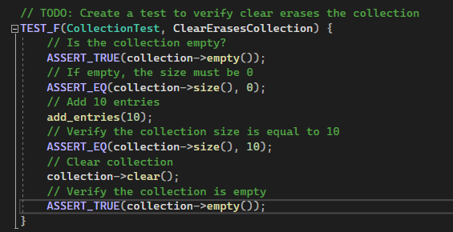

ClearErasesCollection
Unit Testing
Test to verify ‘clear’ erases the collection.

Slide 9
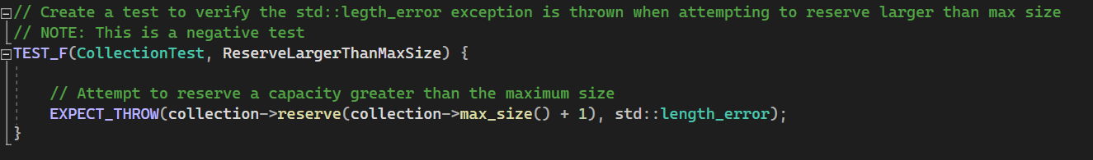

ReserveLargerThanMaxSize
Unit Testing
Test to verify the ‘std::legth_error’ exception is thrown when attempting to reserve larger than max size.

Slide 10
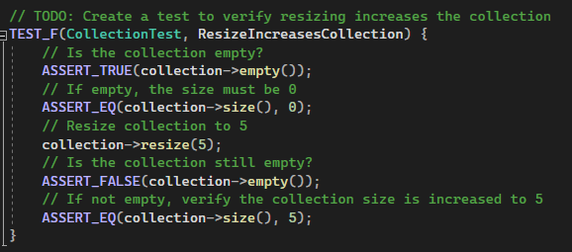

ResizeIncreasesCollection
Unit Testing
Test to verify ‘resizing’ increases the collection.

Slide 11
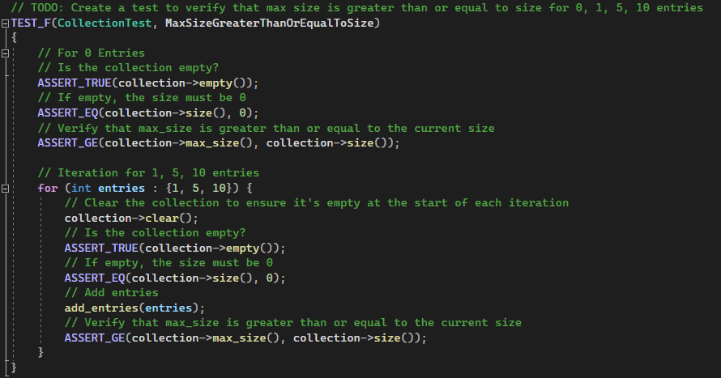

MaxSizeGreaterThanOrEqualToSize
Unit Testing
Test to verify that max size is greater than or equal to size for X entries.

Slide 12
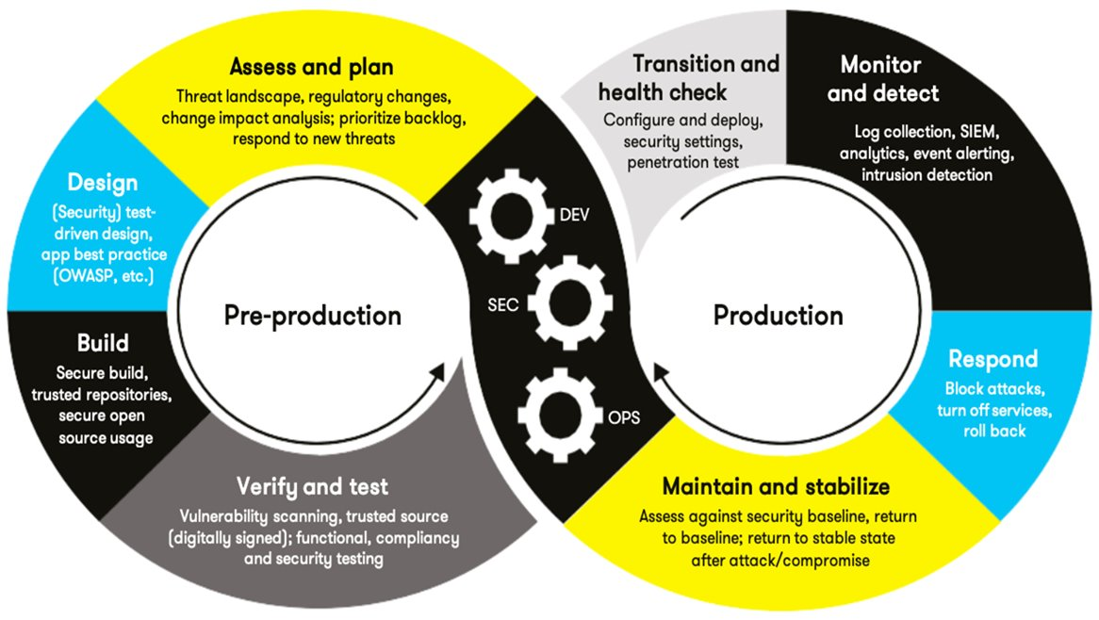
AUTOMATION SUMMARY
Automation will be used for the enforcement and compliance of standards defined in this policy.
It will apply these standards across multiple areas within the existing DevOps Framework.
Automation will streamline security tasks which will enhance efficiency and security without compromising compliance or quality.

Slide 13
TOOLS
Recommended Automation
CodeSonar
Perform static analysis and detect software vulnerabilities in pre-production
Detect any new and emerging vulnerabilities.
https://codesecure.com/our-products/codesonar/
Parasoft C/C++
Verification of unit testing, functional testing and compliance.
Maintain system stability and provide health checks.
https://www.parasoft.com/products/parasoft-c-ctest/
“DevSecOps, short for Development Security Operations, refers to the concept of making software security a core part of the overall software development process.” (Palo Alto Networks)
CppCheck
Identify syntax errors, undefined behaviors and memory leaks.
Detect new emerging issues with a changing environment.
https://cppcheck.sourceforge.io/
Burp-Suite
Open-Source software used during post-production for penetration testing
https://portswigger.net/burp/pro

Slide 14
RISKS AND BENEFITS
“Don’t leave security to the end!”
Risk:
Increased exposure to common attacks.
Delayed response to breach.
Misuse of sensitive data.
Potential for financial and reputational loss.
Benefits:
Mitigate risk of security breaches saving time & money.
Faster response times minimizing operational or financial impact.
Maintain compliance with best security practices.
Reduces risk of insider threats.
Early detection of threats.

Slide 15
RECOMMENDATIONS
While the existing policy provides a solid foundation, a few gaps remain that may expose Green Pace:
Looking at History:
Equifax - Due to a delayed incident response following a major data breach resulted in increased fines & damages cost the company 700M in settlements. (Hiremath, O. [n.d.])
LifeLabs – The lack of Defense in Depth strategy and missing security policies led to a breach of sensitive customer information which led to a $1.2 billion lawsuit. (Hiremath, O. [n.d.])
Defense in Depth Strategy
Lacks details of implementation on layered defense across all of software development.
Incident Response Plan (IRP)
Lacks detailed guidance in the event of a breach or attack.
Improvements should include an up-to-date disaster recovery plan.
Enforcement
Lacks standard on how policies will be enforced and followed correctly.
Improvements should include further details on how standards are applied to day-to-day practice and how they may be enforced.
Improvements should outline details of each part of Defense in Depth.
Controls
Lacks details on access and audit controls.
Further iterations should outline categorization of company data and who has authority over that data.

Slide 16
CONCLUSIONS
Recommended Standards:
Adopting a security first mindset
1
Creates a culture which teams prioritize integrating security.
Encourages to collaborate, improve and share responsibility.
Aligning to ISO standards
2
Provides a structed framework to manage risk & protect data.
Ensures continuous improvements of security controls.
Following NIST Guidelines
3
Helps Green Pace create a flexible framework around identifying, protecting, detecting, responding and recovering.
Provides instructions on how to respond to security incidents.
Offers best practice on encryption.

Slide 17
REFERENCES
What is DevSecOps? (n.d.). Palo Alto Networks. https://www.paloaltonetworks.com/cyberpedia/what-is-devsecops
Hiremath, O. (n.d.). The Good, The Bad and the Ugly? Lessons from Incident Responses. https://www.softwaresecured.com/post/lessons-from-incident-responses
Kirvan, P. (2023, October 27). Top 12 IT security frameworks and standards explained. Security. https://www.techtarget.com/searchsecurity/tip/IT-security-frameworks-and-standards-Choosing-the-right-one
SEI CERT C++ Coding Standard - SEI CERT C++ Coding Standard - Confluence. (n.d.). https://wiki.sei.cmu.edu/confluence/pages/viewpage.action?pageId=88046682

